Slide 1
Geografski informacioni sistemi domaći II
Branislav Jovičić, 1003

Slide 2
PostgreSQL sa PostGIS ekstenzijom
podaci su preuzeti sa http://download.geofabrik.de/europe/serbia.html u vidu .pbf fajla
izvršeni upiti:
prikaži sve fakultete u Nišu
prikaži sve restorane blizu centra Niša
prikaži sve spomenike duž obala Nišave
prikaži sve autobuske linije koje prolaze kroz datu autobusku stanicu
prikaži sve lokacije pešačkih prelaza na datoj ulici
navedeni upiti su izvršeni sa i bez prostornih indeksnih struktura
poređenje srednjih vremena izvršenja

Slide 3
PostgreSQL sa PostGIS ekstenzijom:
podržani tipovi geo-prostornih podataka:
Point, LineString, Polygon
kolekcije - MultiPoint, MultiLineString, MultiPolygon, GeometryCollection
podržane operacije/funkcije nad geo-prostornim podacima:
ST_X(geometry), ST_Y(geometry) vraćaju koordinate podatka tipa Point
ST_Length(geometry), ST_StartPoint(geometry), ST_EndPoint(geometry), ST_NPoints(geometry) za rad sa podacima tipa LineString
ST_Area(geometry), ST_NRings(geometry), ST_ExteriorRing(geometry), ST_InteriorRingN(geometry,n), ST_Perimeter(geometry) za rad sa podacima tipa Polygon
ST_NumGeometries(geometry), ST_GeometryN(geometry,n), ST_Area(geometry), ST_Length(geometry) za rad sa kolekcijama
ST_GeomFromText(text, srid), ST_AsText(geometry) i drugi za konverziju zapisa geo-prostornih podataka
ST_Equals(geometry A, geometry B), ST_Intersects(geometry A, geometry B), ST_Disjoint(geometry A , geometry B), ST_Crosses(geometry A, geometry B), ST_Overlaps(geometry A, geometry B), ST_Within(geometry A , geometry B), ST_Contains(geometry A, geometry B), ST_Distance(geometry A, geometry B) i druge za ispitivanje relacije između geo-prostornih podataka
...
indeksne strukture za podršku upitima nad geo-prostornim podacima:
R-Tree indeksna struktura
podrška za mešovite upite

Slide 4
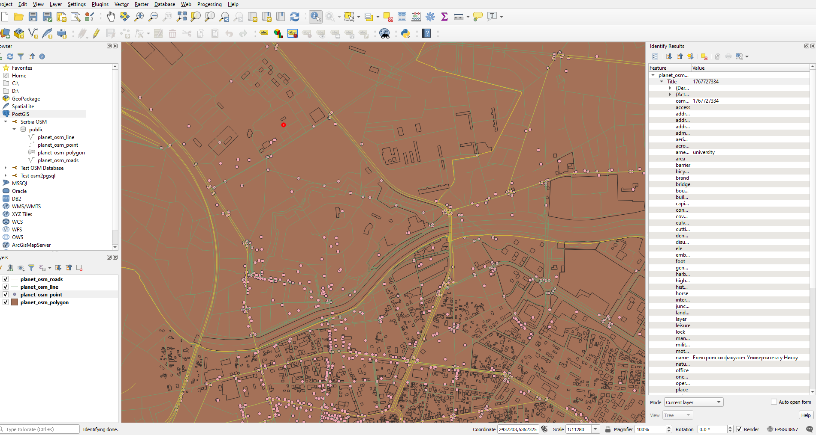
preuzeti prostorni podaci Srbije

Slide 5
prikaži sve fakultete u Nišu
select
points.name as university_name,
ST_Transform(points.way, 4326) as geometry
from planet_osm_polygon as polygons
join planet_osm_point as points
on ST_Contains(polygons.way, points.way)
where polygons.name = 'Град Ниш' and
points.amenity = 'university';

Slide 6
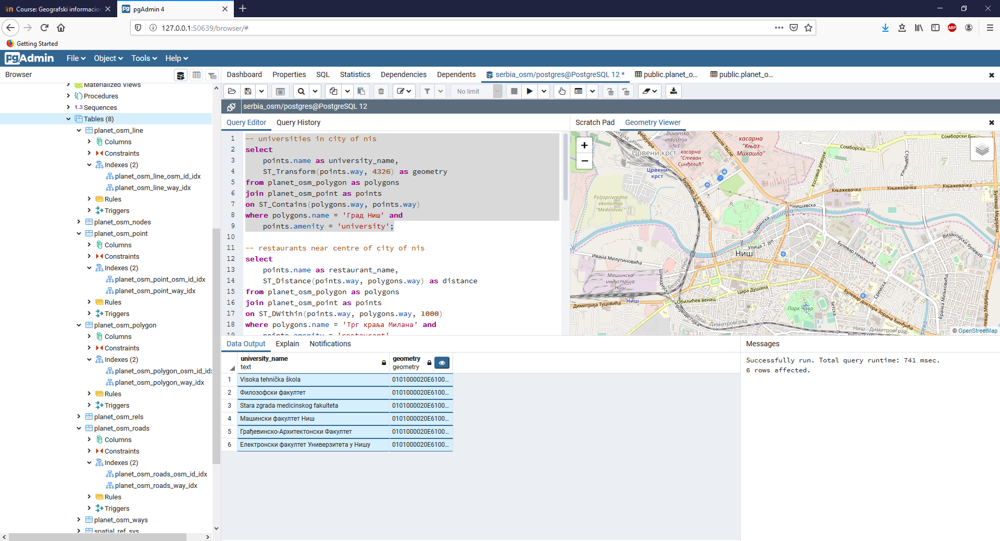
vreme izvršenja sa indeksom - 0.741 s

Slide 7
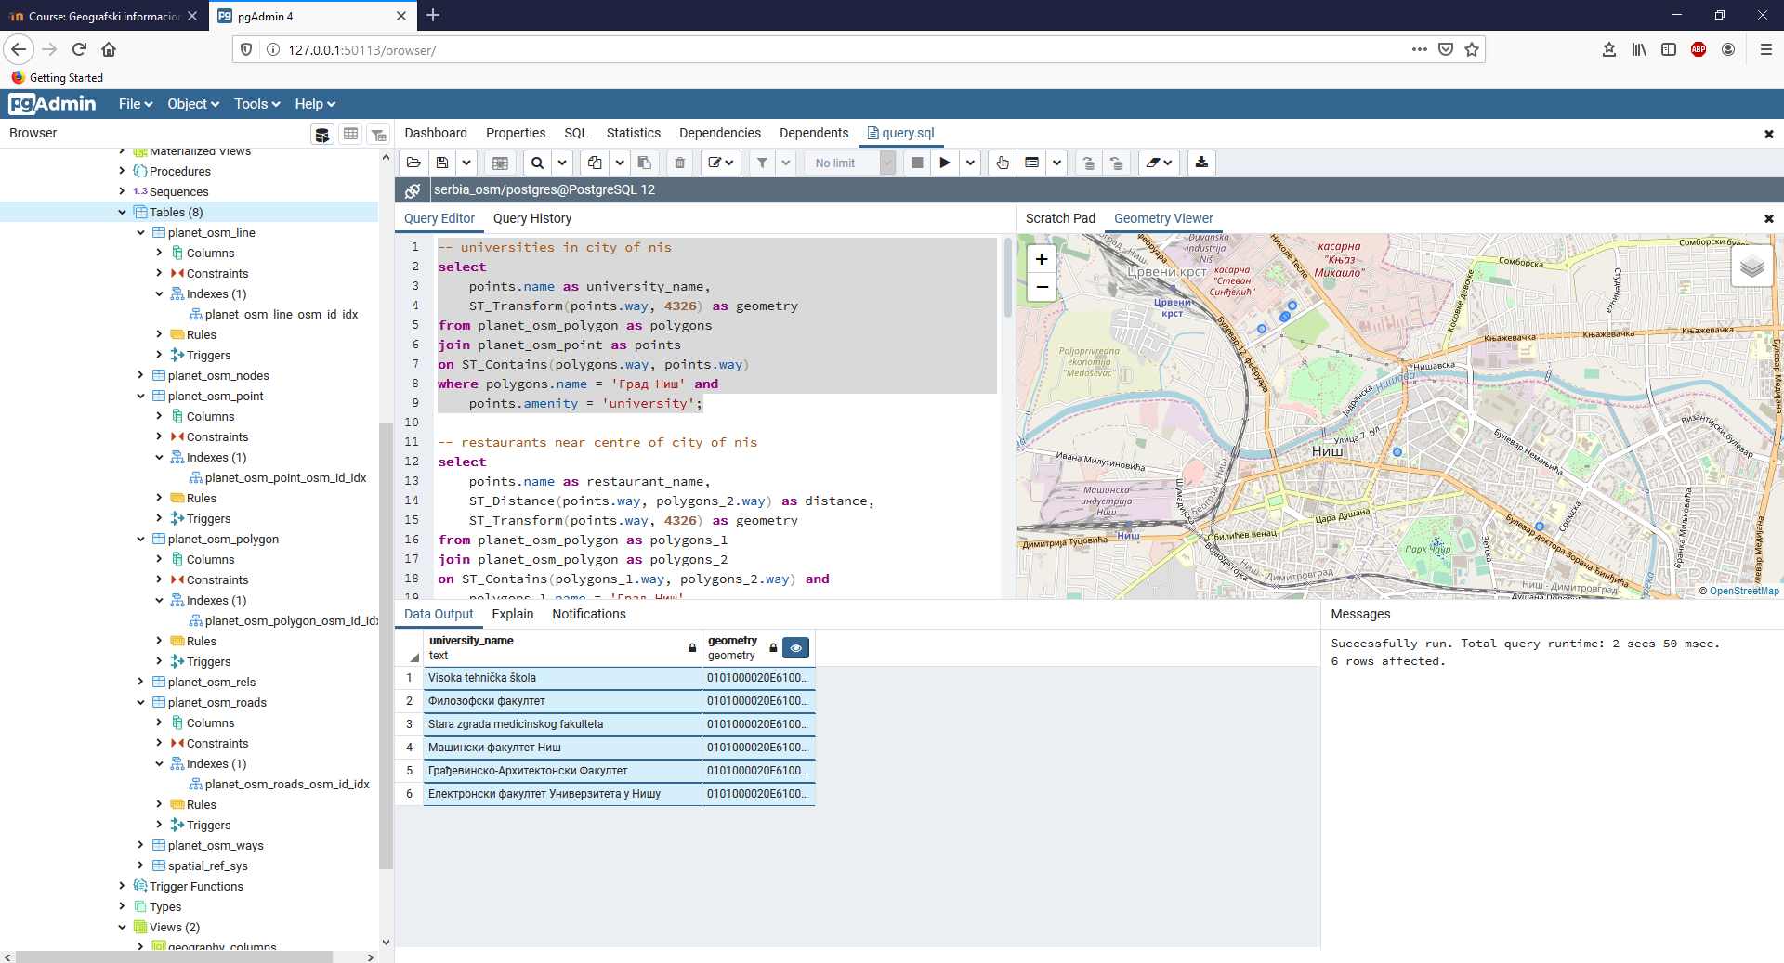
vreme izvršenja bez indeksa - 2.05 s (+ 1.309 s)

Slide 8
prikaži sve restorane blizu centra Niša
select
points.name as restaurant_name,
ST_Distance(points.way, polygons_2.way) as distance,
ST_Transform(points.way, 4326) as geometry
from planet_osm_polygon as polygons_1
join planet_osm_polygon as polygons_2
on ST_Contains(polygons_1.way, polygons_2.way) and
polygons_1.name = 'Град Ниш'
join planet_osm_point as points
on ST_DWithin(points.way, polygons_2.way, 500)
where polygons_2.name = 'Трг краља Милана' and
points.amenity = 'restaurant'
order by distance ASC;

Slide 9
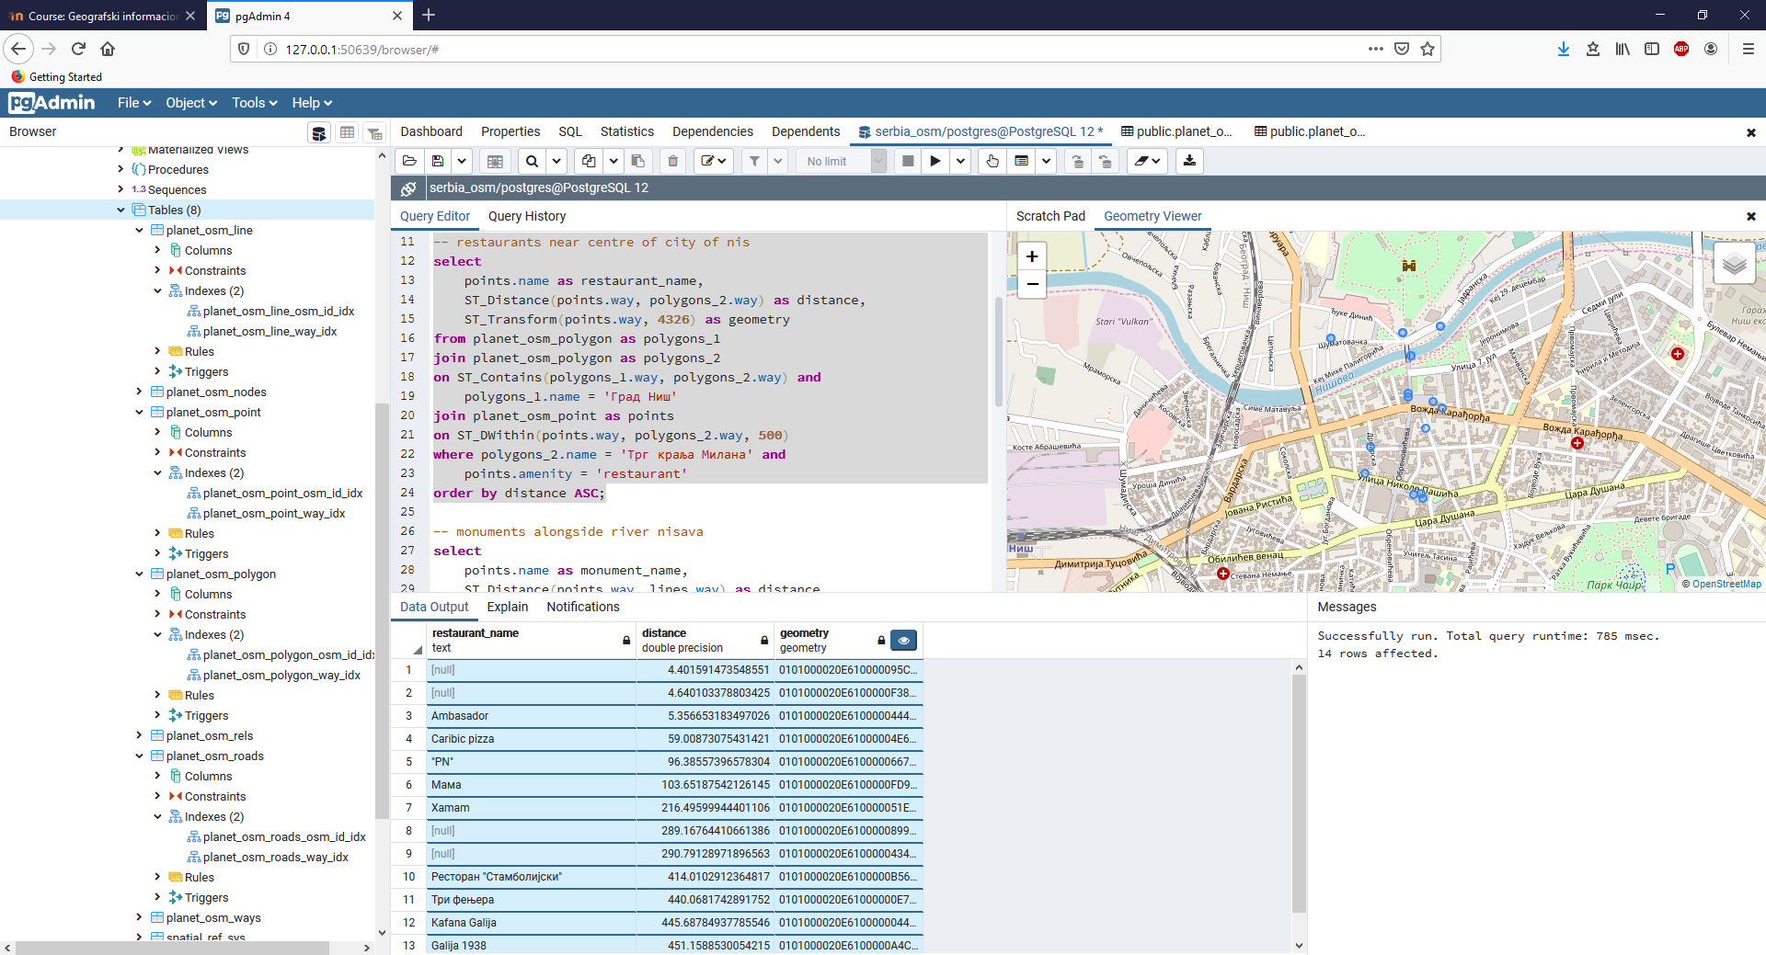
vreme izvršenja sa indeksom - 0.785 s

Slide 10
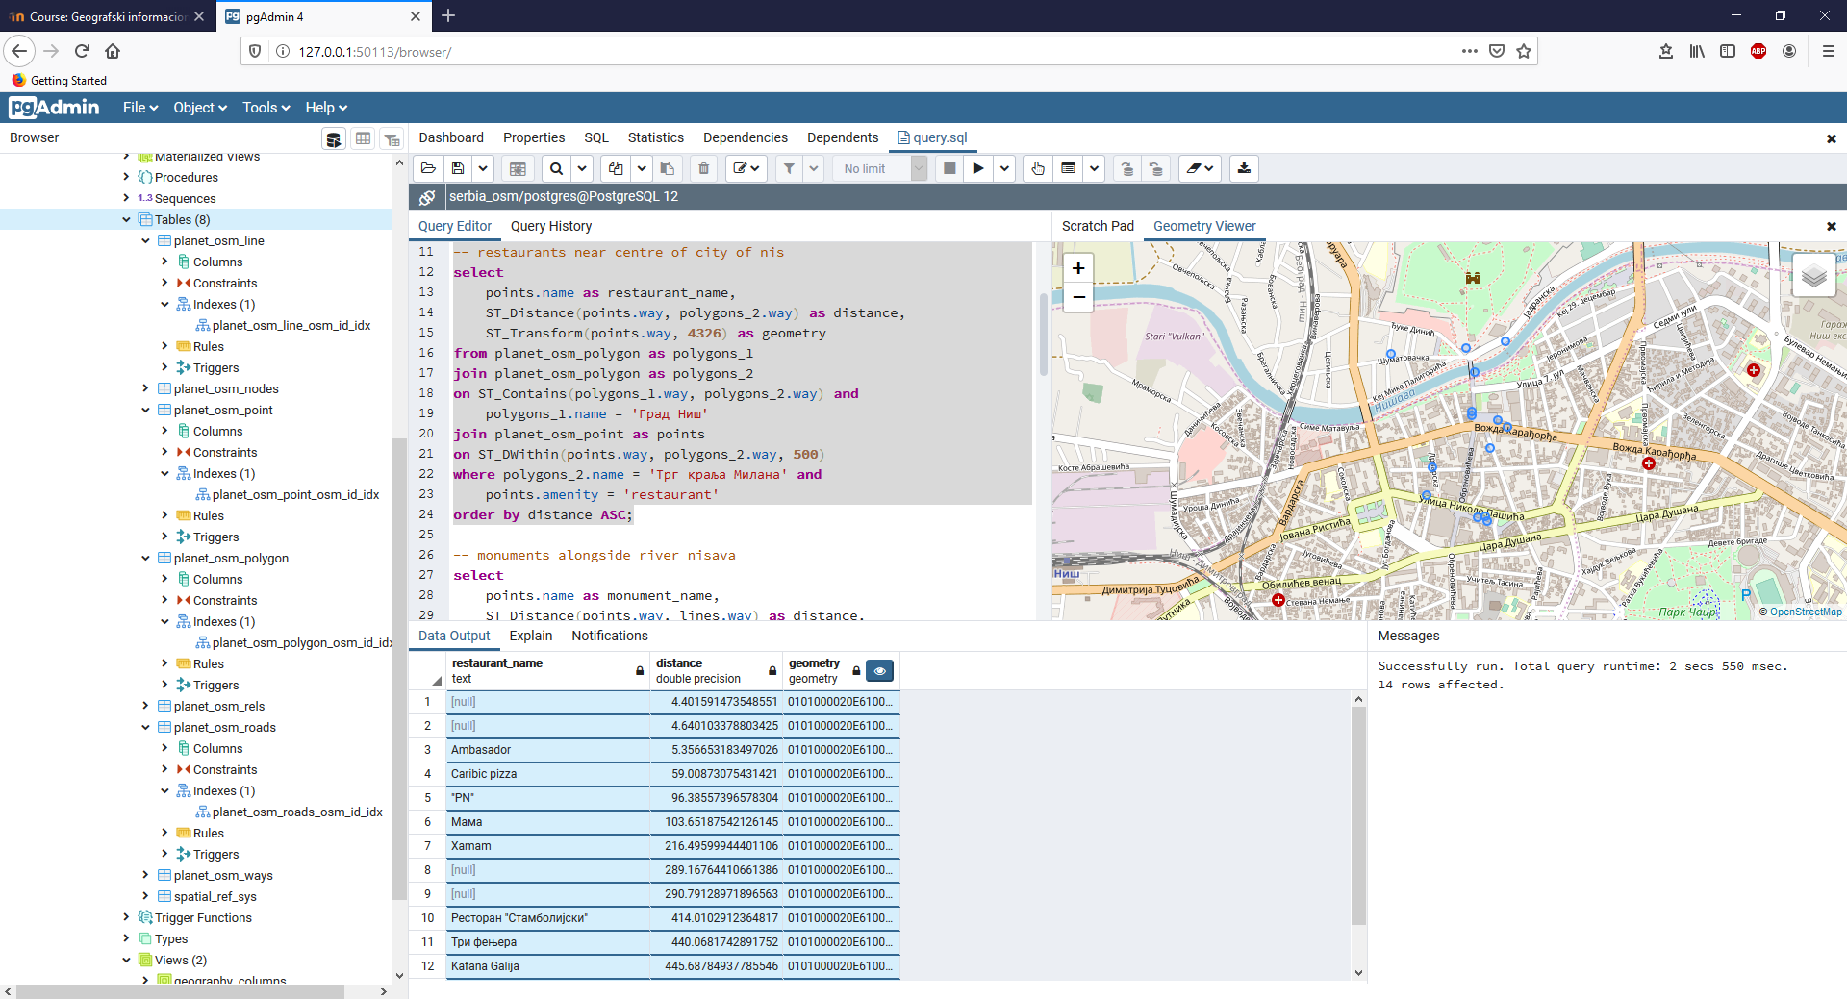
vreme izvršenja bez indeksa - 2.55 s (+ 1.765 s)

Slide 11
prikaži sve spomenike duž obala Nišave
select
points.name as monument_name,
ST_Distance(points.way, lines.way) as distance,
ST_Transform(points.way, 4326) as geometry
from planet_osm_line as lines
join planet_osm_point as points
on ST_DWithin(points.way, lines.way, 1000)
where lines.waterway = 'river' and lines.name = 'Нишава' and
points.historic = 'monument';

Slide 12
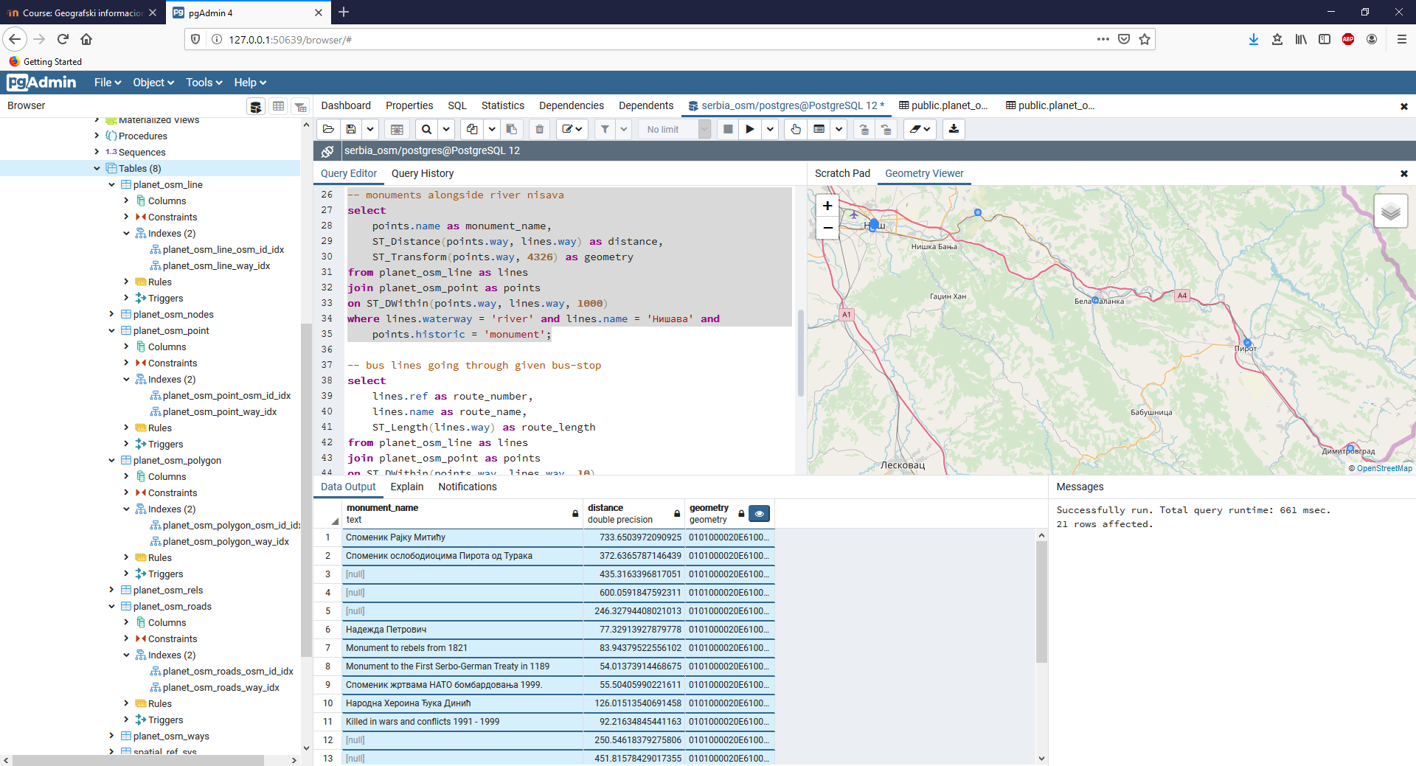
vreme izvršenja sa indeksom - 0.661 s

Slide 13
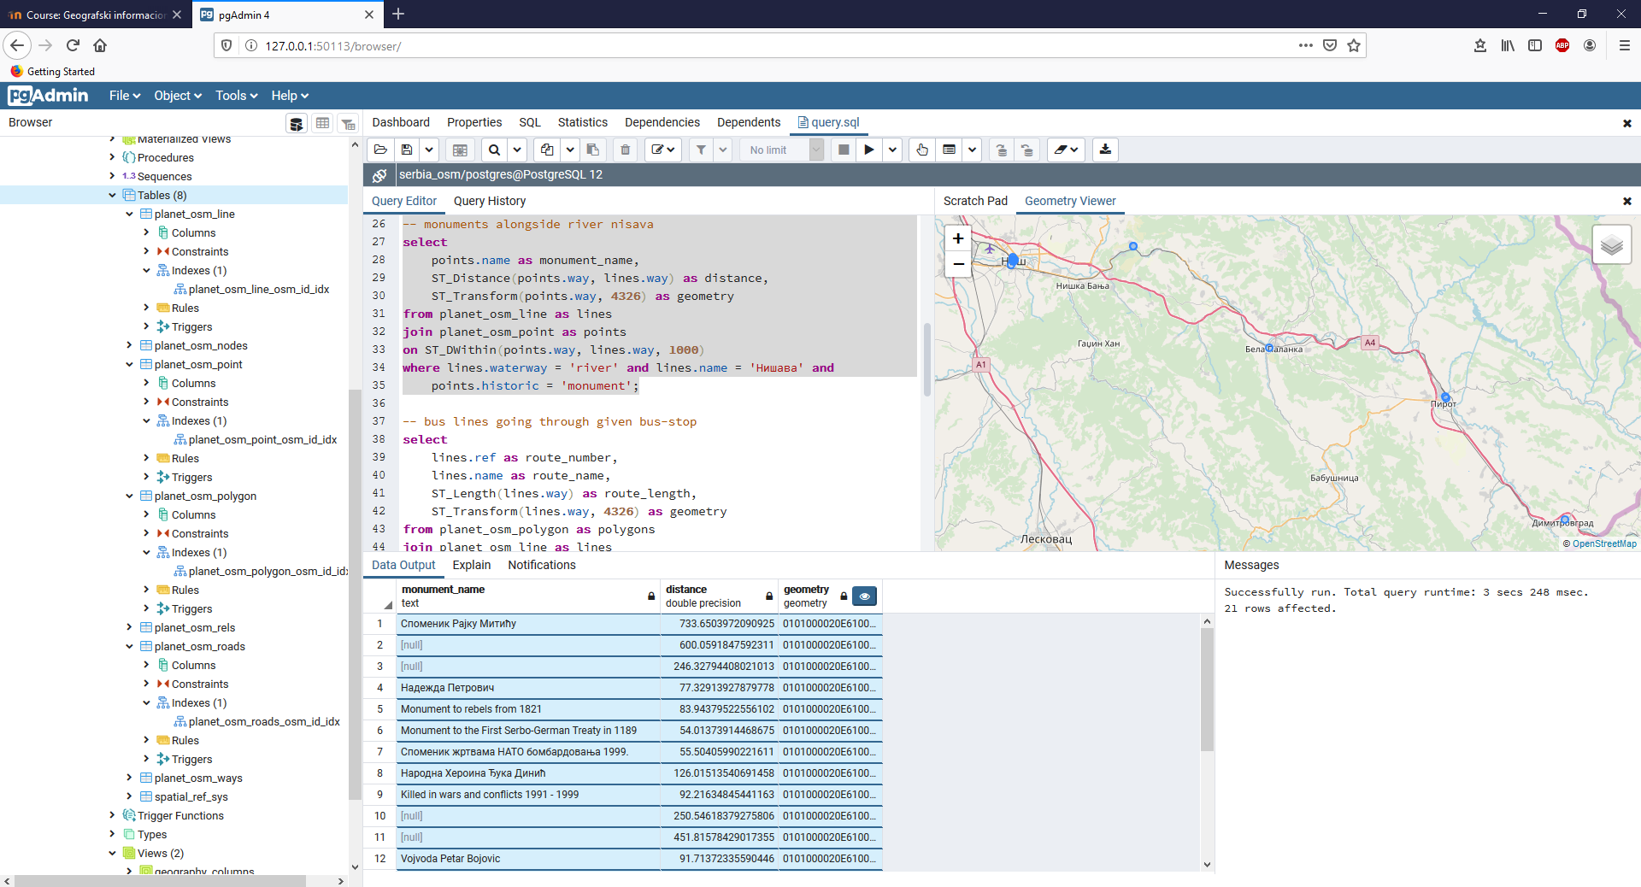
vreme izvršenja bez indeksa - 3.248 s (+ 2.587 s)

Slide 14
prikaži sve autobuske linije koje prolaze kroz datu autobusku stanicu
select
lines.ref as route_number,
lines.name as route_name,
ST_Length(lines.way) as route_length,
ST_Transform(lines.way, 4326) as geometry
from planet_osm_polygon as polygons
join planet_osm_line as lines
on ST_Contains(polygons.way, lines.way) and
polygons.name = 'Град Ниш'
join planet_osm_point as points
on ST_DWithin(points.way, lines.way, 10)
where lines.route = 'bus' and
points.highway = 'bus_stop' and points.name = 'Трг краља Милана';

Slide 15
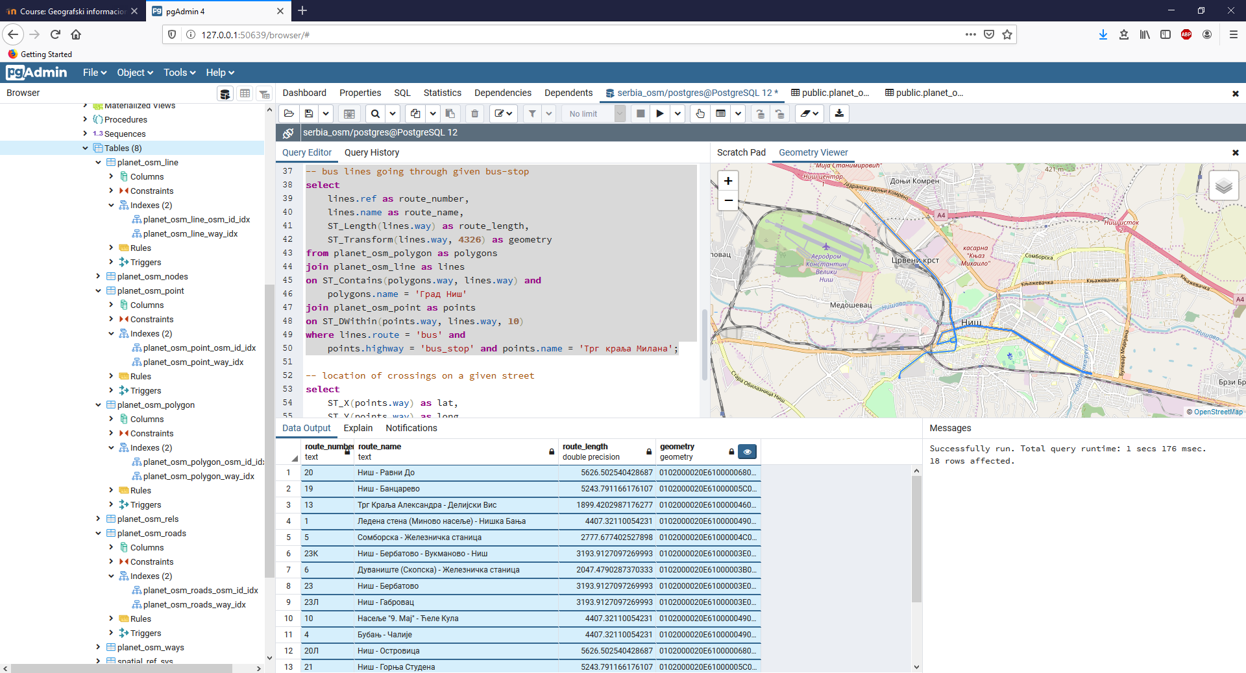
vreme izvršenja sa indeksom - 1.176 s

Slide 16
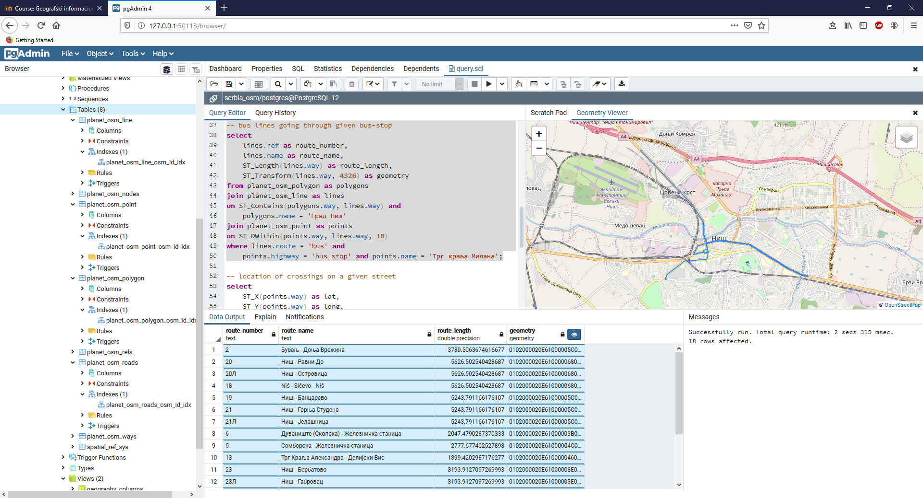
vreme izvršenja bez indeksa - 2.315 s (+ 1.139 s)

Slide 17
prikaži sve lokacije pešačkih prelaza na datoj ulici
select
ST_X(points.way) as lat,
ST_Y(points.way) as long,
ST_Transform(points.way, 4326) as geometry
from planet_osm_roads as roads
join planet_osm_polygon as polygons
on ST_Contains(polygons.way, roads.way) and polygons.name = 'Град Ниш'
join planet_osm_point as points
on ST_Intersects(points.way, roads.way)
where roads.name = 'Вожда Карађорђа' and
points.highway = 'crossing';

Slide 18
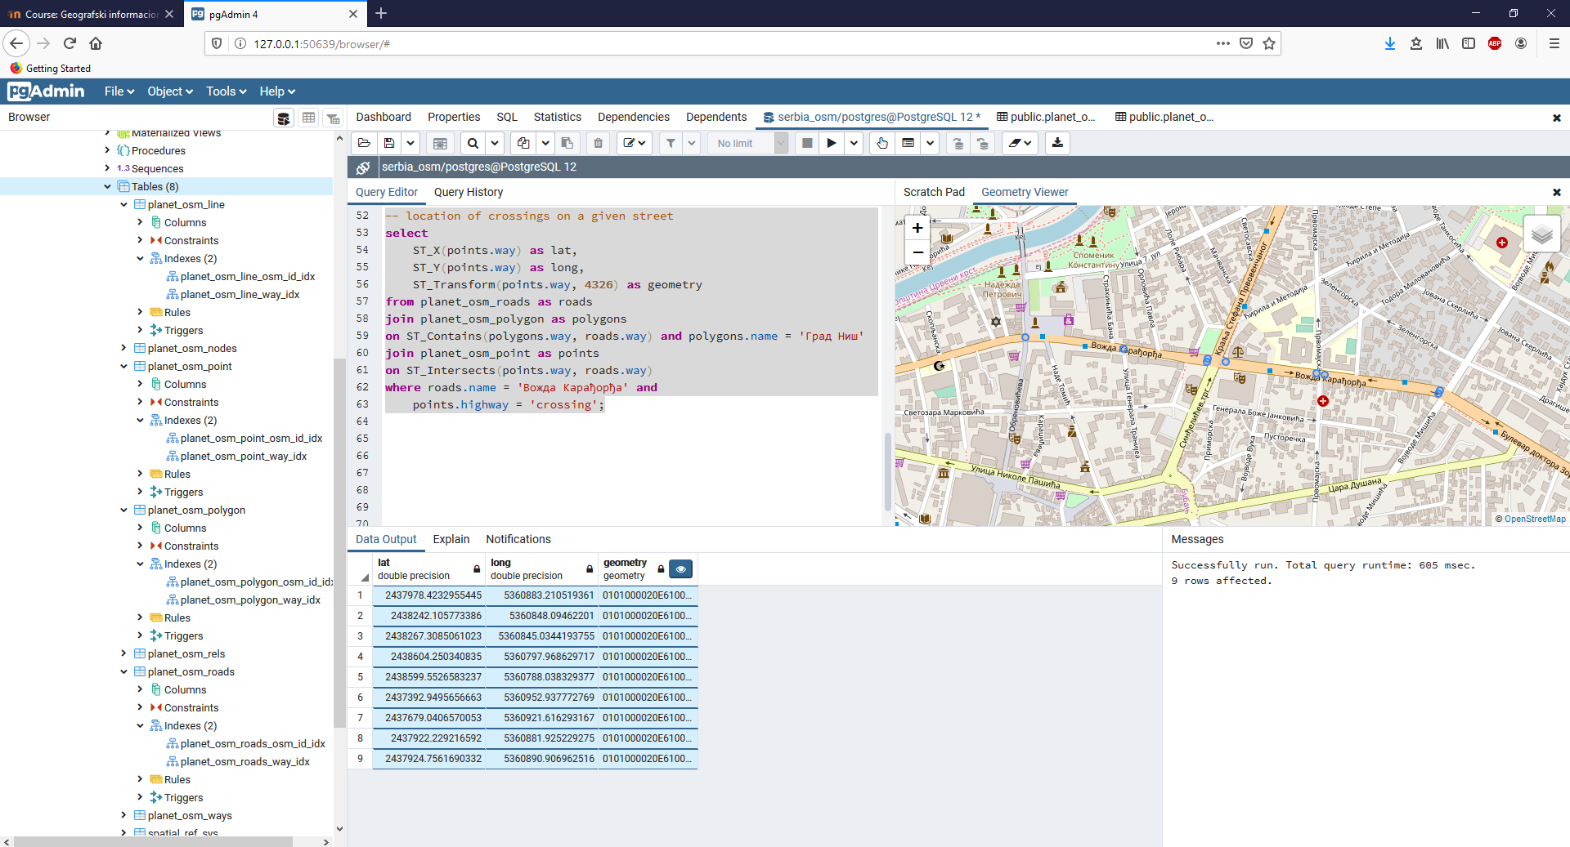
vreme izvršenja sa indeksom - 0.605 s

Slide 19
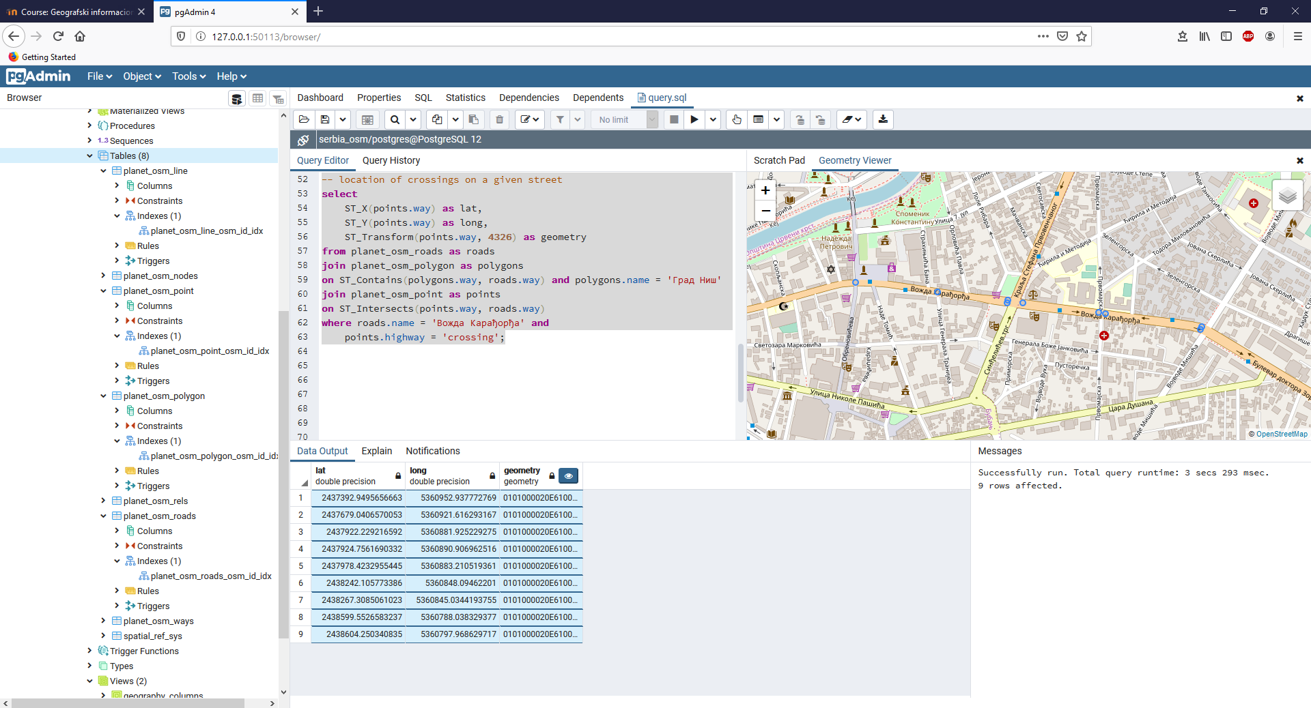
vreme izvršenja bez indeksa - 3.293 s (+ 2.688 s)

Slide 20
Geografski informacioni sistemi domaći II
Branislav Jovičić, 1003

